Slide 1




NEXT GEN EMPLOYABILITY PROGRAM
Creating a future-ready workforce
Team Members
College Name
Student Name: JERALD DAVID RAJ J
Student ID: au814721104027
SRM TRP ENGINEERING COLLEGE

Slide 2

CAPSTONE PROJECT SHOWCASE
Project Title
Notes Sharing Web Application using Django Framework
Abstract | Problem Statement | Project Overview | Proposed Solution | Technology Used | Modelling & Results | Conclusion

Slide 3
Abstract
Notesphere is a web application designed with the objective of facilitating seamless note sharing among users. Built on the robust Django framework, the platform offers a user-friendly interface where individuals can effortlessly create, upload, access, and distribute notes within a secure environment.
Central to Notesphere's functionality is its emphasis on user security and privacy. Through the implementation of stringent security measures such as encrypted data transmission, secure user authentication protocols, and meticulous permission controls, the platform ensures the safeguarding of user information and content integrity.
By enabling users to register accounts, securely log in, and efficiently manage their notes, Notesphere fosters a collaborative ecosystem where knowledge exchange thrives. Whether for educational purposes, professional endeavors, or personal enrichment, Notesphere serves as a reliable tool for users to engage, collaborate, and organize their notes effectively.

Slide 4
Problem Statement
In today's digitally driven world, the demand for efficient note-sharing platforms has escalated, spurred by the need for seamless collaboration and knowledge dissemination. However, existing solutions often fall short in providing a comprehensive, secure, and user-friendly environment for individuals to share and manage their notes effectively.
Inadequate Note-Sharing Solutions:
Existing methods for sharing notes, such as email attachments or physical copies, are cumbersome and inefficient.
Security and Privacy Concerns:
Users are increasingly concerned about the security and privacy of their data when using online platforms.
Lack of Comprehensive Platform:
There is a clear gap in the market for a comprehensive note-sharing web application that addresses the shortcomings of existing solutions.

Slide 5
Project Overview
NoteSphere is an innovative web application designed to address the existing gap in the market for a comprehensive note-sharing platform. Leveraging cutting-edge technologies, NoteSphere aims to transform the way individuals share, collaborate, and manage their notes seamlessly.
Intuitive Interface: NoteSphere boasts a user-friendly interface, ensuring effortless navigation and accessibility for users of all skill levels.
Advanced Collaboration Tools: Unlike conventional note-sharing platforms, NoteSphere offers advanced collaboration tools to facilitate seamless interaction among users.
Cross-Platform Compatibility: NoteSphere is designed to be compatible across multiple devices and operating systems, ensuring users can access their notes anytime, anywhere.

Slide 6
Proposed Solution
The NoteSphere Web Application built on the Django framework offers a robust solution to the challenges encountered in note-taking, organization, and sharing. Here's how the application addresses each problem:
Centralized Platform:
The application provides a unified platform where users can perform all note-related tasks, including creation, editing, organization, and sharing. This eliminates the need for users to switch between multiple tools or platforms.
Security Measures:
Robust security measures are implemented to ensure the safety and privacy of user data. This includes encryption of sensitive information, secure authentication mechanisms (such as OAuth or JWT), and role-based access control to manage user permissions.

Slide 7
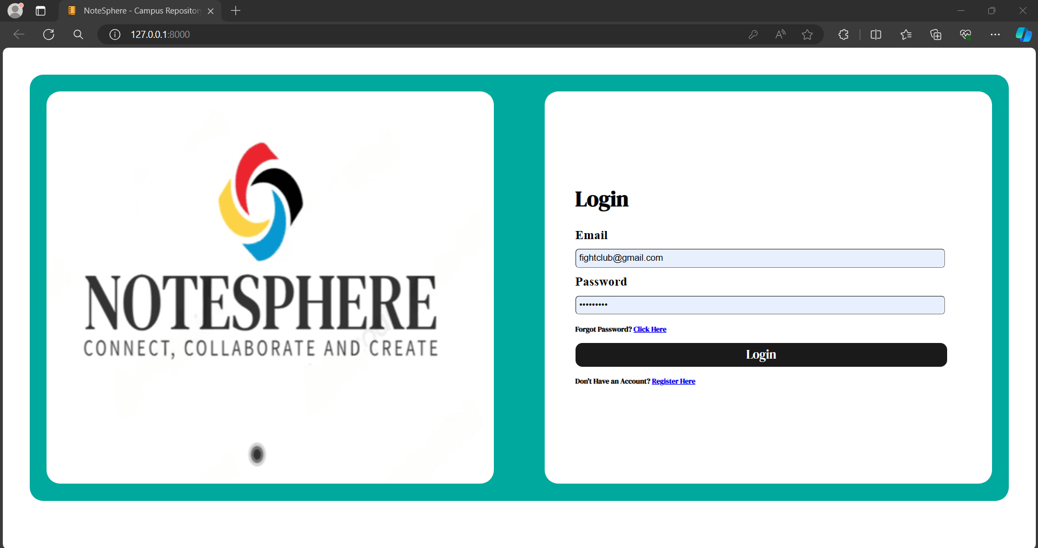
Login page

Slide 8
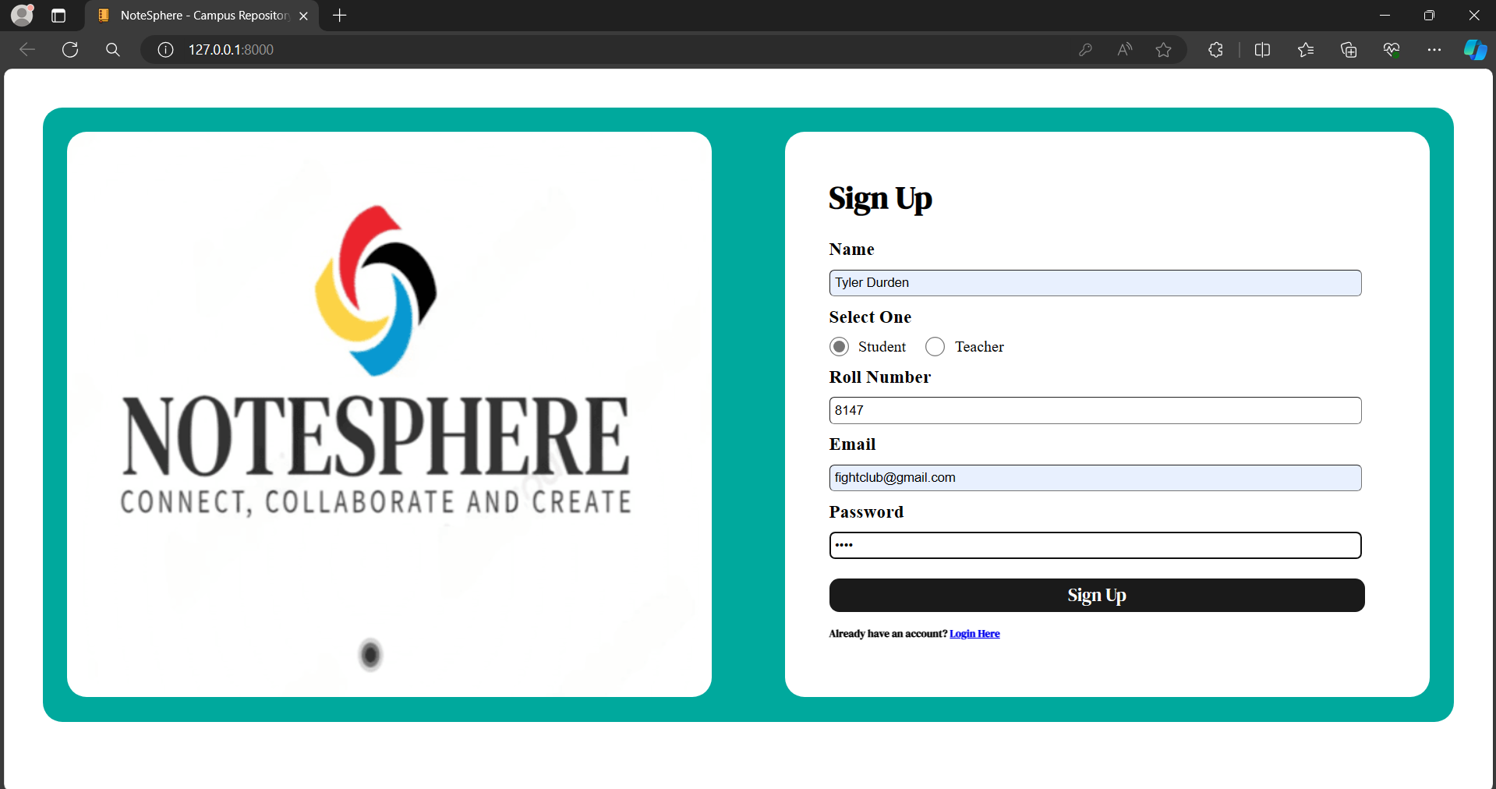
Student’s login

Slide 9
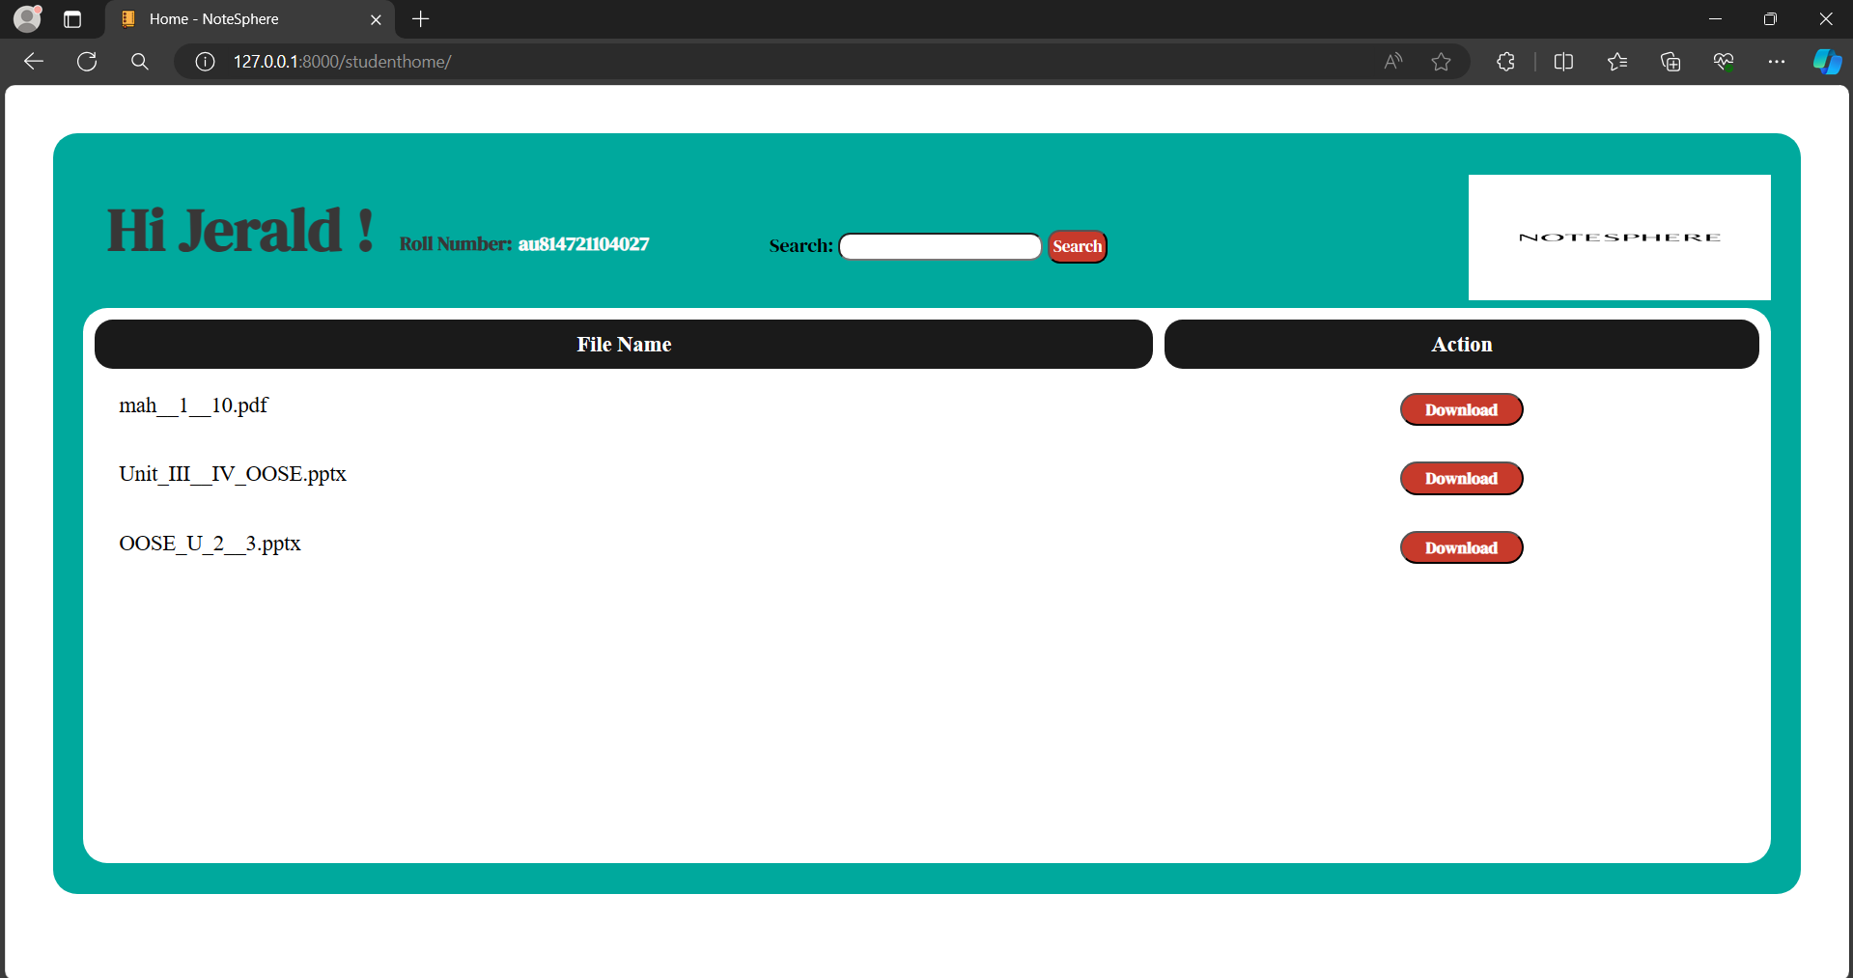
Student’s page

Slide 10

Teacher’s login

Slide 11
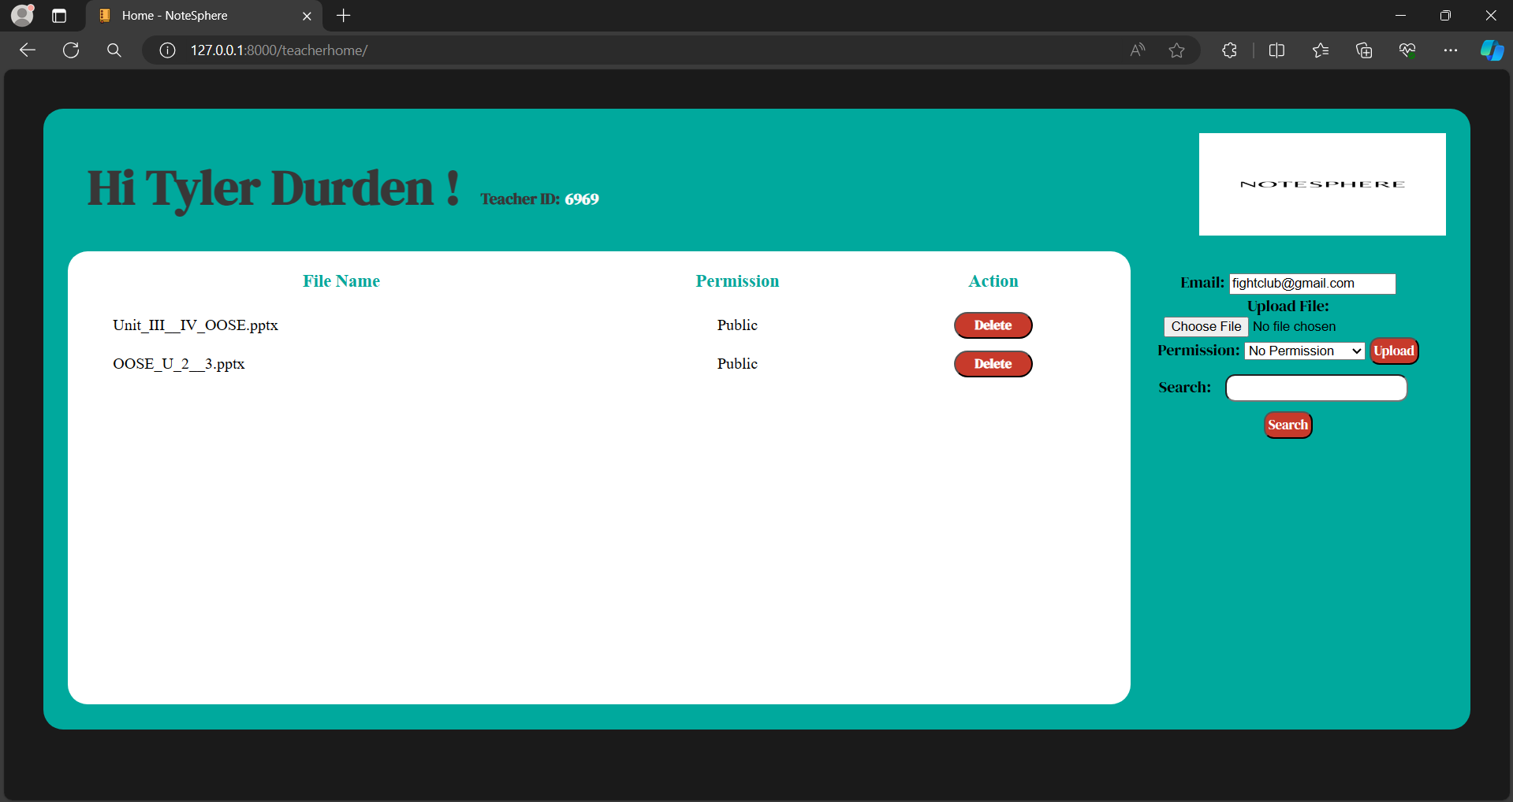
Teacher’s Page

Slide 12
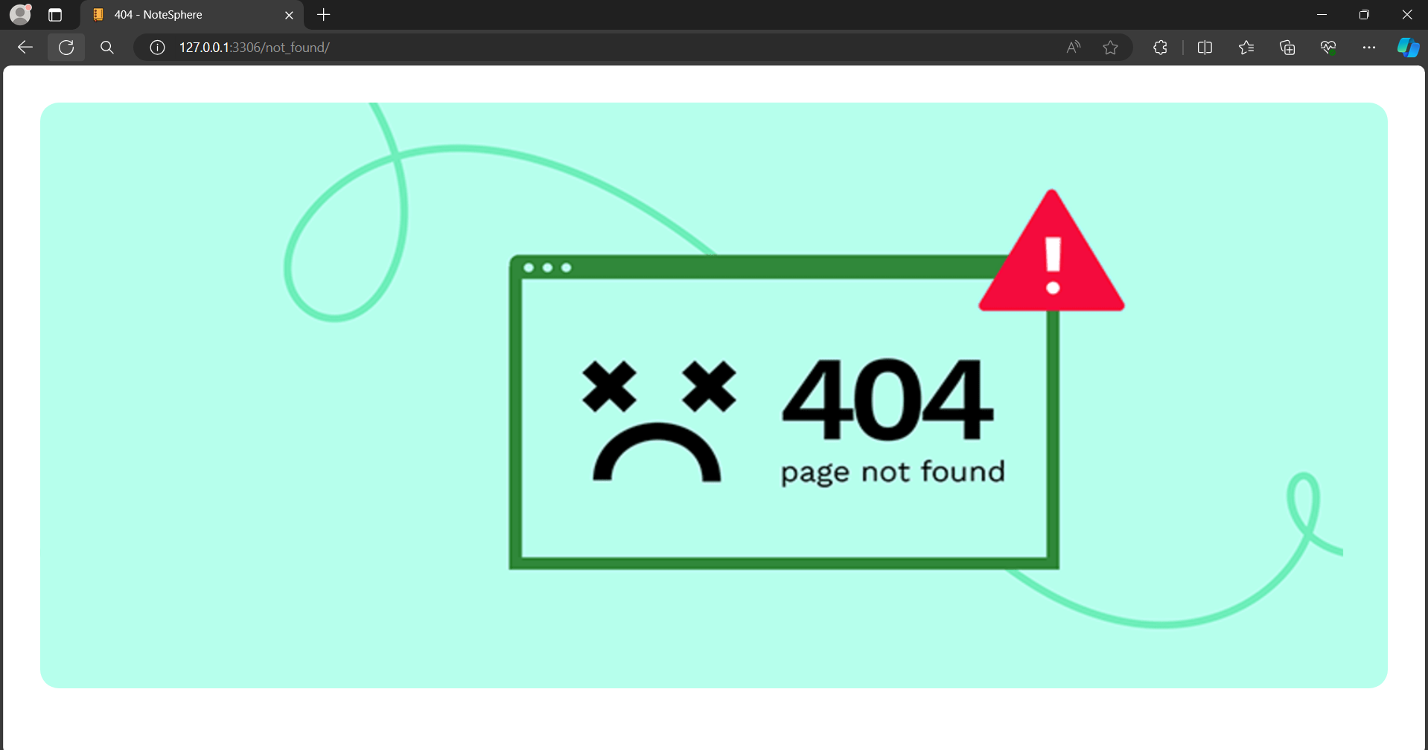
404 error

Slide 13
Future Enhancements
Advanced Collaboration Features
Integration with External Tools
Enhanced Security Measures
Mobile Application Support
Accessibility Features
Community and User Feedback Integration
Offline Access and Synchronization
Customizable Templates and Workflows
Analytics and Insights

Slide 14
Conclusion
The NotesSphere Web Application developed on the Django framework presents a comprehensive solution to the challenges encountered in note-taking, organization, and sharing. By providing a centralized platform with robust security measures, advanced collaboration features, efficient organization tools, and a user-friendly interface, the application aims to streamline workflows, enhance productivity, and facilitate seamless knowledge sharing among users.
Overall, the NoteSphere Web Application serves as a valuable tool for individuals, teams, and organizations seeking to streamline their note-taking processes, collaborate effectively, and harness the power of shared knowledge. Through continuous refinement and innovation, the application will continue to evolve and remain a vital asset for users in their quest for productivity and collaboration excellence.

Slide 15
Thank You!
Notes:
Thank You !!

